Slide 1
VENTRICULAR RHYTHMS
BY
UMAR AMINU IBRAHIM
JULY, 2025.

Slide 2
Objectives
• Recognize ventricular dysrhythmias on EKG and relate cause, significance, symptoms, and treatment.

Slide 3
Ventricular rhythms
• When the sinoatrial (SA) node and the AV Junctional tissues fails to generate an
impulse the ventricles will assume the role of pacing the heart.
• There is an absence of P waves because there is no atrial activity or depolarization.
• Ventricular rhythms will display QRS complexes that are wide (greater than or equal to 120 milliseconds) and bizarre in appearance.

Slide 4
Ventricular rhythms
This is rhythm initiated at the level of the ventricules, also known as ideal ventricular rhythm or idioventricular rhythm or ventricular escape rhythm. The resting rate is 20 to 40/minutes.
Keys to identifying: rhythm is SLOW, no P wave, wide & bizarre QRS!

Slide 5
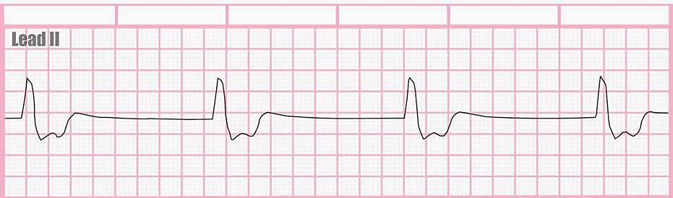
EXAMPLE 1. IDIOVENTRICULAR RHYTHM
• Absence P wave
• Wide QRS complex
• Rate 37 beats per minute (bpm)

Slide 6
Ventricular rhythms
Causes
• Drugs- Digitalis
• MI
• Metabolic imbalances
• Hyperkalemia
Medical Treatment
▪ Atropine
▪ Pacing
▪ Dopamine when hypotensive
▪ CPR

Slide 7
Accelerated Idioventricular Rhythm (AIVR)
Accelerated idioventricular arrhythmia is last-ditch effort of the ventricles to try to prevent cardiac standstill.
• SA node and AV node have failed
• Rate usually between 40 to 120 beats per minute (bpm)

Slide 8
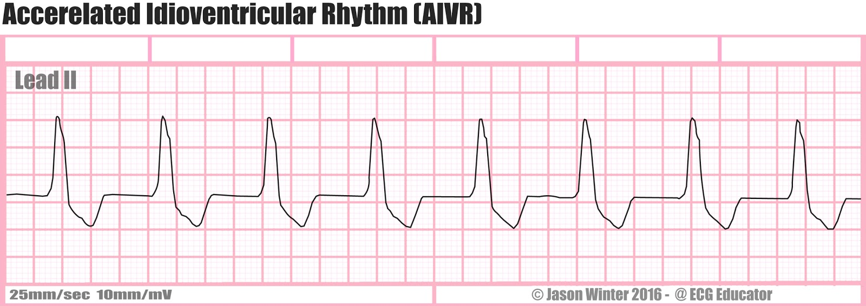
EXAMPLE. ACCELERATED IDOVENTRICULAR RHYTHM (AIVR)
• Absence P wave
• Wide QRS complex
• Rate 88bpm

Slide 9
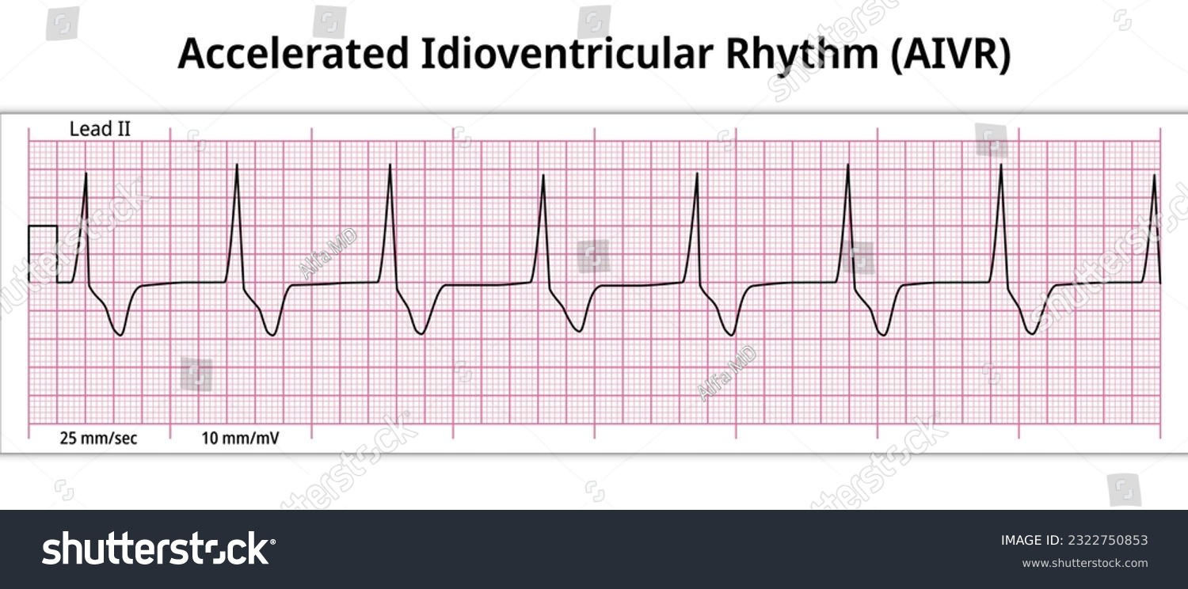
Example 2. AIVR
• Absence P wave
• Wide QRS complex
• Rate 300/5 = 60bpm

Slide 10
VENTRICULAR TACHYCARDIA
▪ Ventricular tachycardia almost always occurs in diseased hearts.
▪ Rhythm in which three or more PVCs arise in sequence at a rate greater than 150 beats per
minute and above.
▪ V-tach can quickly deteriorate into ventricular fibrillation. The causes includes ischemia heart disease and cardiomyopathy.
• Antiarrhythmics drugs such as Amiodaron are used to restore nomal heart rate.

Slide 11
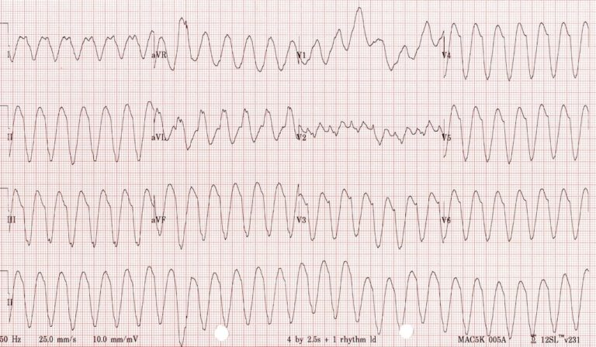
EXAMPLE OF VENTRICULAR TACHYCARDIA (V-TACH)

Slide 12
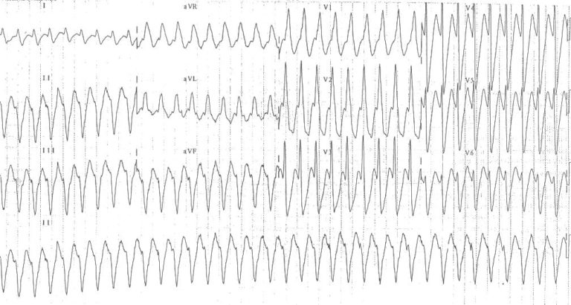
EXAMPLE 2. V-tach

Slide 13
VENTRICULAR FIBRILLATION
Ventricular fibrillation (VF) is the most important shockable cardiac arrest rhythm.
Rate: 300 to 500bpm.
The ventricles suddenly attempt to contract at rates of up to 500 bpm

Slide 14
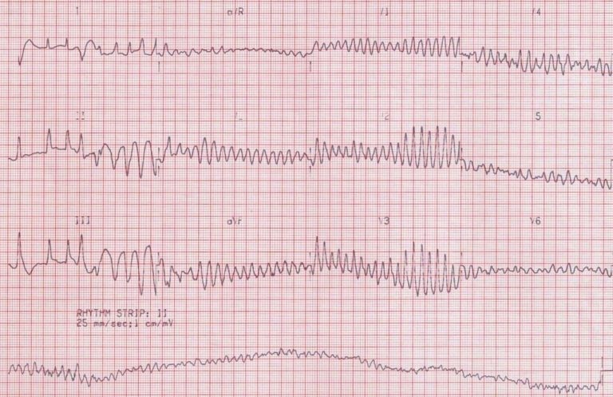
EXAMPLE OF VENTRICULAR FIBRILLATION
Chaotic irregular deflections without identifiable P-QRS-T waves

Slide 15
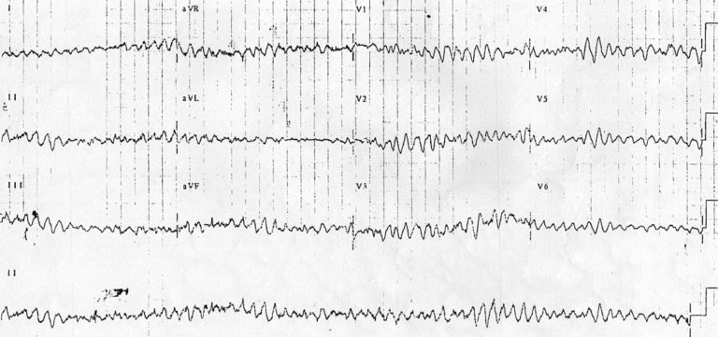
EXAMPLE 2. VENTRICULAR FIBRILLATION
Chaotic irregular deflections without identifiable P-QRS-T waves

Slide 16
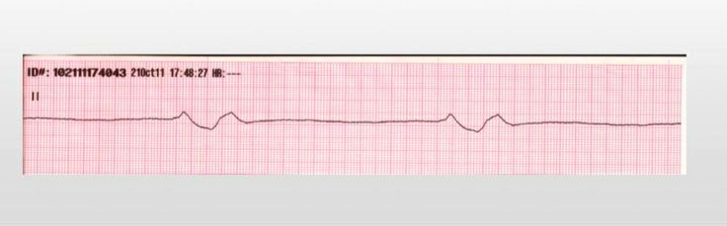
Agonal Rhythm
Agonal rhythm is when the Idioventricular rhythm is 20 beats or less per minute. Frequently is seen as the last-ordered semblance of a heart rhythm when resuscitation efforts are unsuccessful.

Slide 17
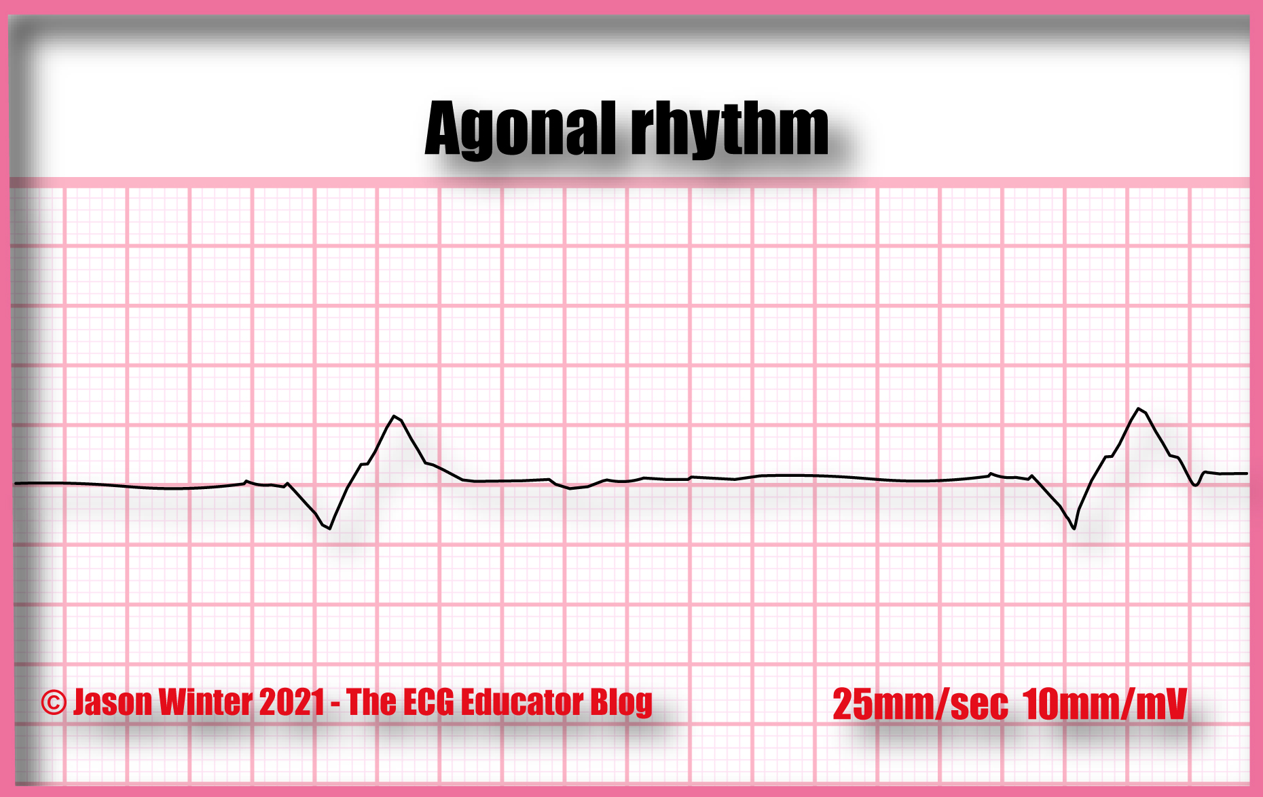
Another Example Of Agonal Rhythm
Medical Treatment is High Chest Compression CPR.

Slide 18
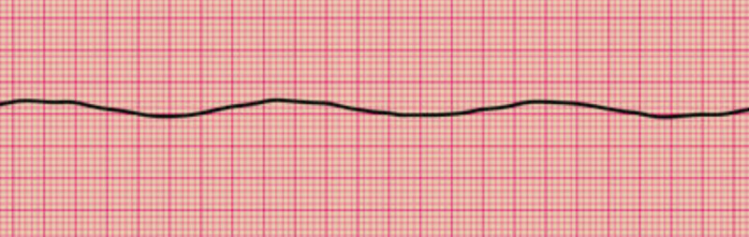
Asystole
▪ Ventricular standstill
▪ No palpable pulse
▪ No measurable BP
▪ Loss of consciousness
Zero Heart rate: Asystole
Treatment: CPR.

Slide 19
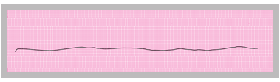
Asystole (Cardiac Standstill)
Zero Heart rate: Asystole
Treatment: Cardiopulmonary resuscitation

Slide 20
THANK YOU

